Slide 1
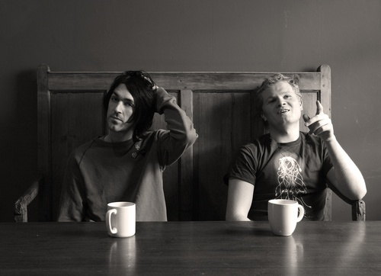
Duologues & sCENES
Drama
Year 9
Lesson 7

Slide 2
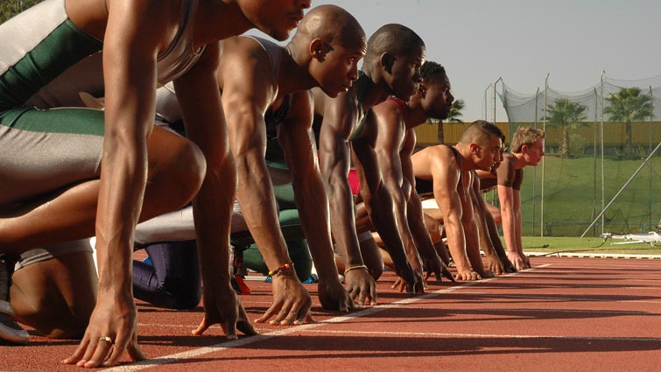
LESSON OBJECTIVES
To rehearse and perform Duologues and scenes.

Slide 3
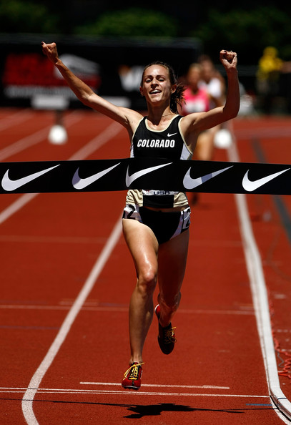
LESSON OUTCOME
LEVEL 4
I will know that I can rehearse and perform a duologue or scene.
LEVEL 5
I will rehearse and perform my duologue or scene to a good standard.
LEVEL 6
I will be able to rehearse and perform a duologue or scene to a high standard.

Slide 4
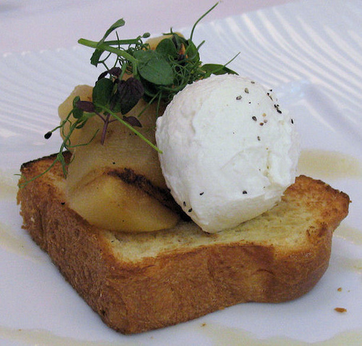
Starter (5mins)
This session is going to be focused on rehearsing and performing our duologue or scenes.

Slide 5
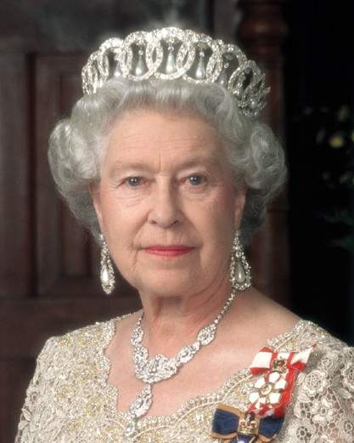
YOUR MAJESTY
Student is chosen to be Queen or King.
The student is blindfolded.
Another student is chosen to say ‘Your Majesty’
The King or Queen must guess who the student is

Slide 6
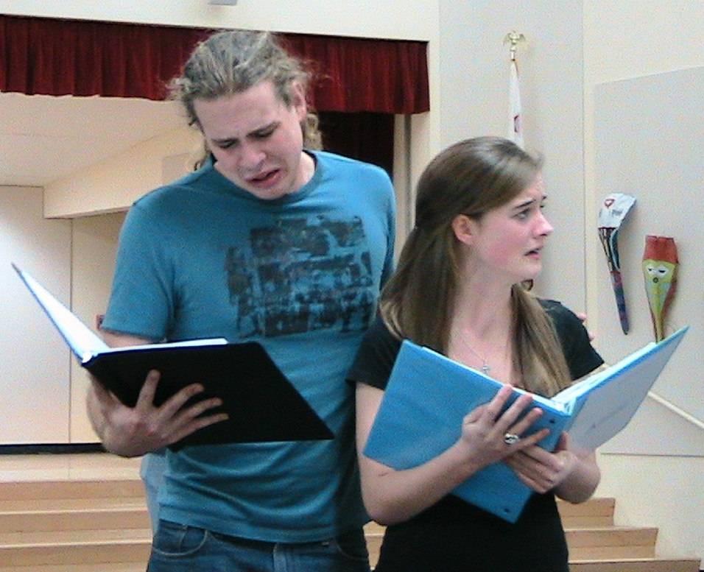
REHEARSALS
Use your time wisely and practice your duologue or scene as you will be performing it in the latter half of the lesson.

Slide 7
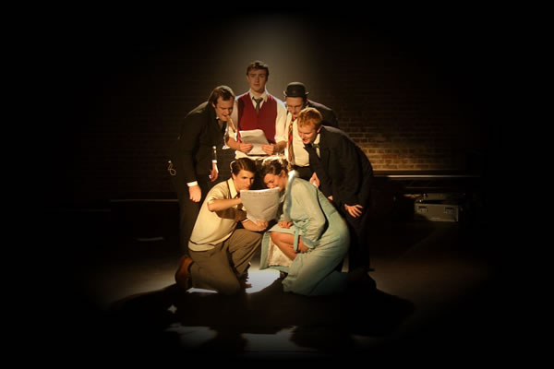
PERFORMANCES
Everyone will perform their duologue or scene to the class.
Remember to...
Stay in Role
Enjoy yourself.
Hold your end position.

Slide 8
EVALUATION
Class will evaluate their peers work
WWW (What Went Well)
EBI (Even Better If)

Slide 9
What did you achieve today? LESSON OUTCOME
LEVEL 4
I will know that I can rehearse and perform a duologue or scene.
LEVEL 5
I will rehearse and perform my duologue or scene to a good standard.
LEVEL 6
I will be able to rehearse and perform a duologue or scene to a high standard.

Slide 10
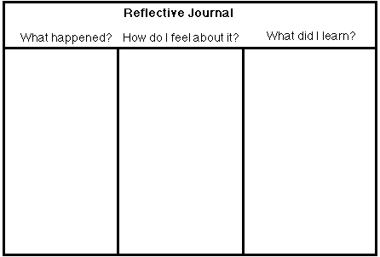
REFLECTIVE LOG
It is important to reflect on every lesson. For assessment it is important to keep a log book of activities, so you must write a reflective log for each lesson.

